Slide 1

E-COMMERCE INTERNET PROGRAMMING LABORATORY (CSE 326) By MUKESH KUMAR SAH PARVEZ ISLAM SADMAN HAQUE SAKIB SECTION: K17CS Submitted To Dr. V Devendran, Assistant Professor SCHOOL OF COMPUTER SCIENCE & ENGINEERING LOVELY PROFESSIONAL UNIVERSITY, JALANDHAR APRIL-2018

Slide 2

E-Commerce means Electronics Commerce, which is also used for selling on the Internet or Online shopping. E-commerce is a kind of trading, products or services, which is conducted via the Internet.

Slide 3
WORK DIVISION OF THE PROJECT
MUKESH KUMAR SAH
HOMEPAGE
CONTACT US PAGE
LOG IN PAGE
PARVEZ ISLAM
APPLIANCE WEBPAGE
PAYMENT PAGE
ADD TO CART
SADMAN HAQUE SAKIB
ELECTRONICS WEBPAGE
CLOTHING ITEMS

Slide 4
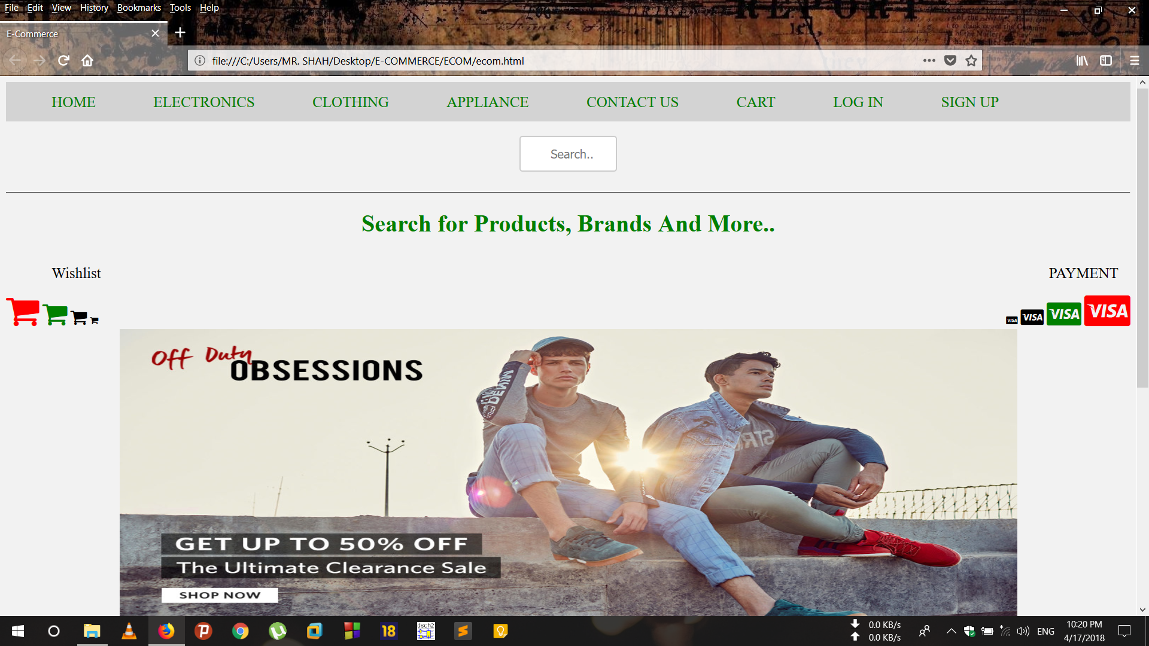
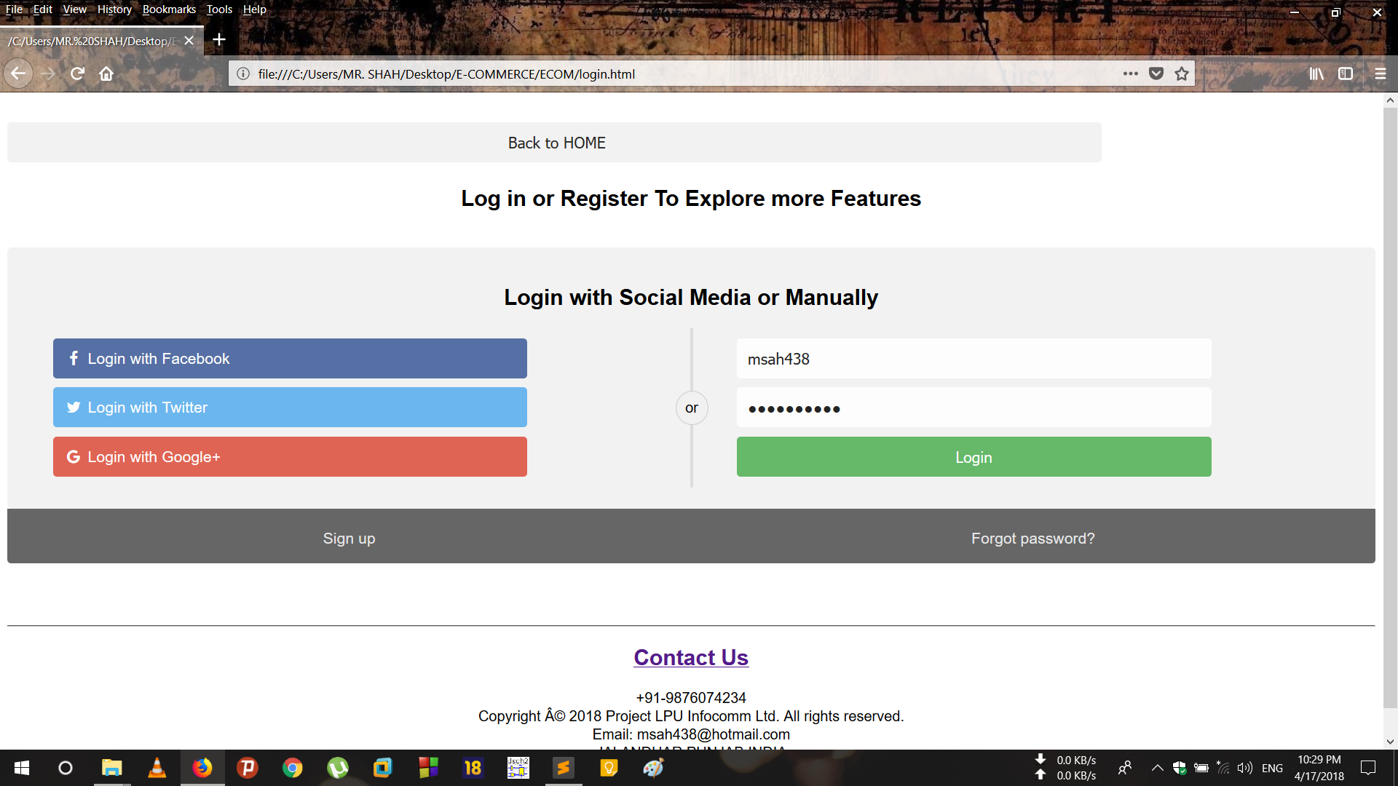
SCREENSHOTS OF THE WEBPAGE-
HOMEPAGE- LOGIN PAGE-

Slide 5
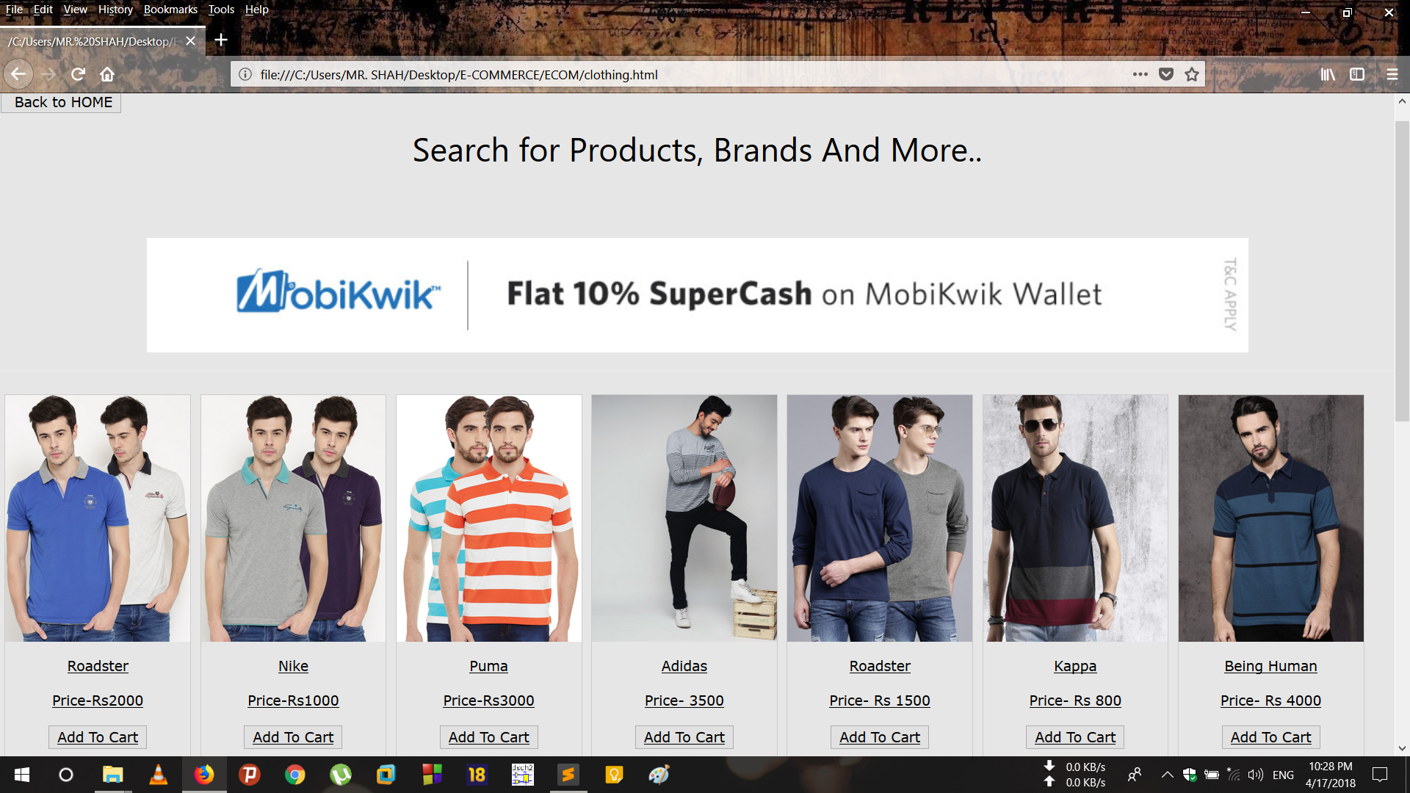
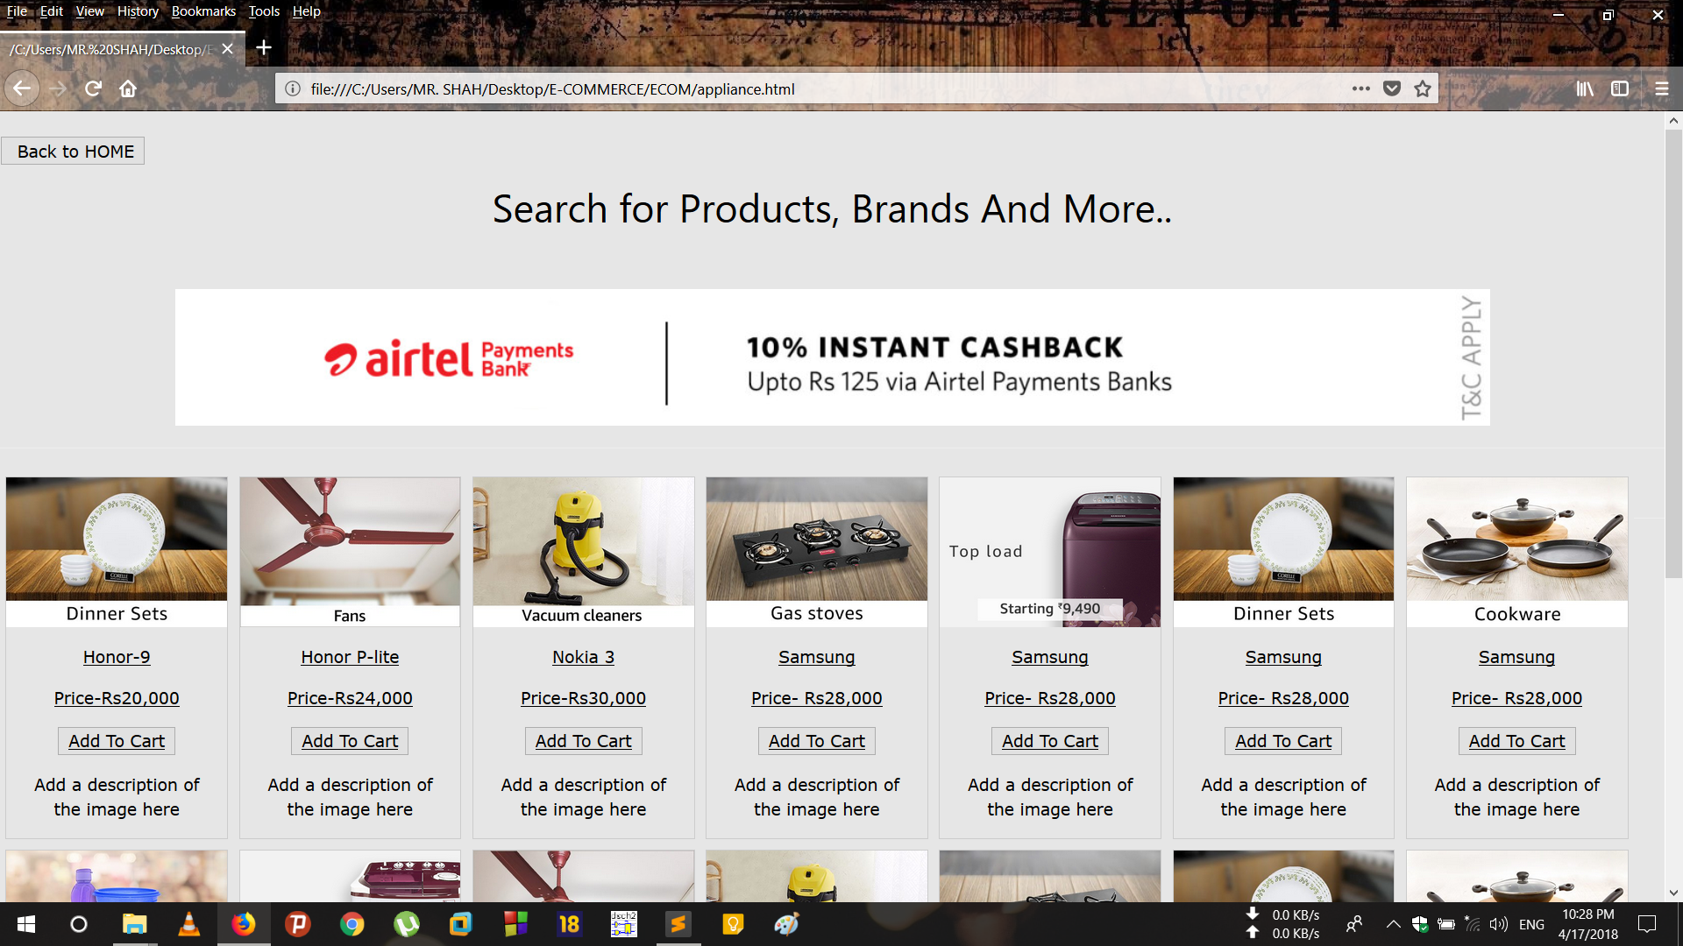
CLOTHING- APPLIANCES-

Slide 6
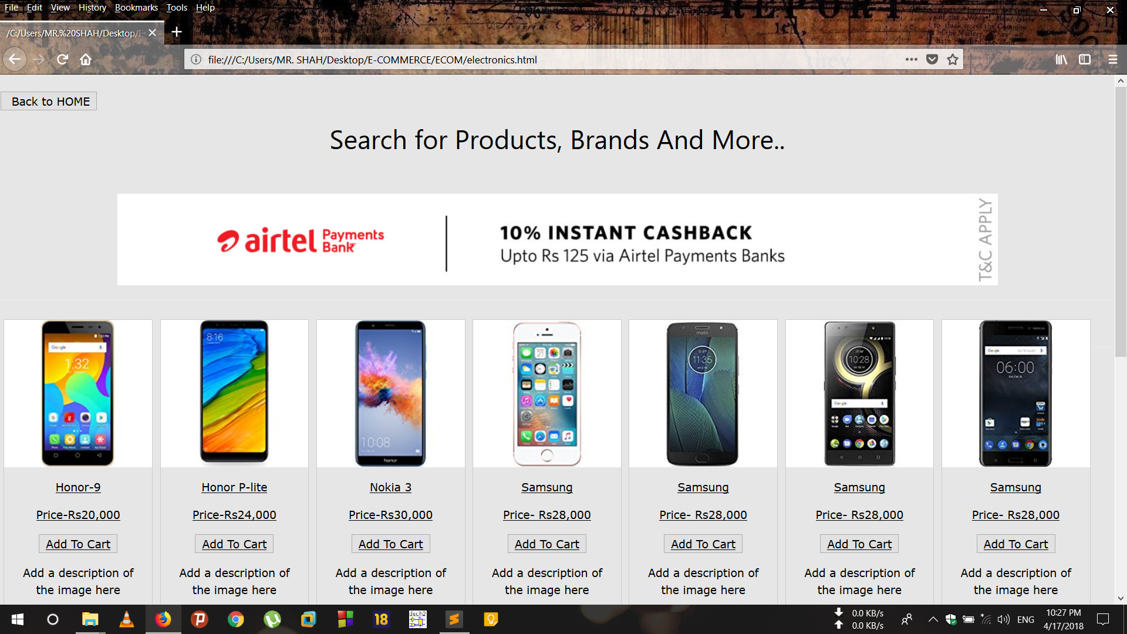
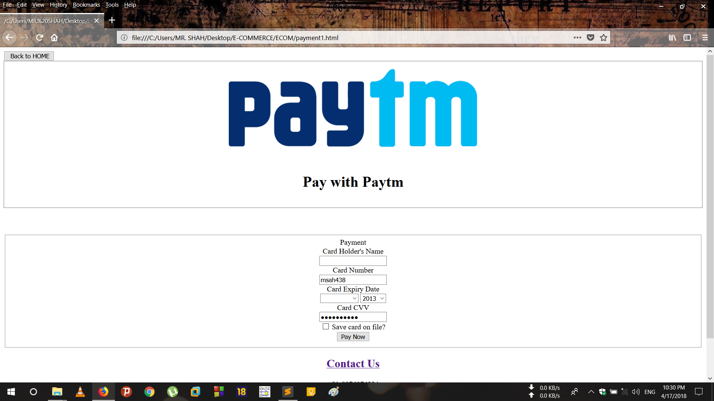
ELECTRONICS- PAYMENT PAGE-

Slide 7
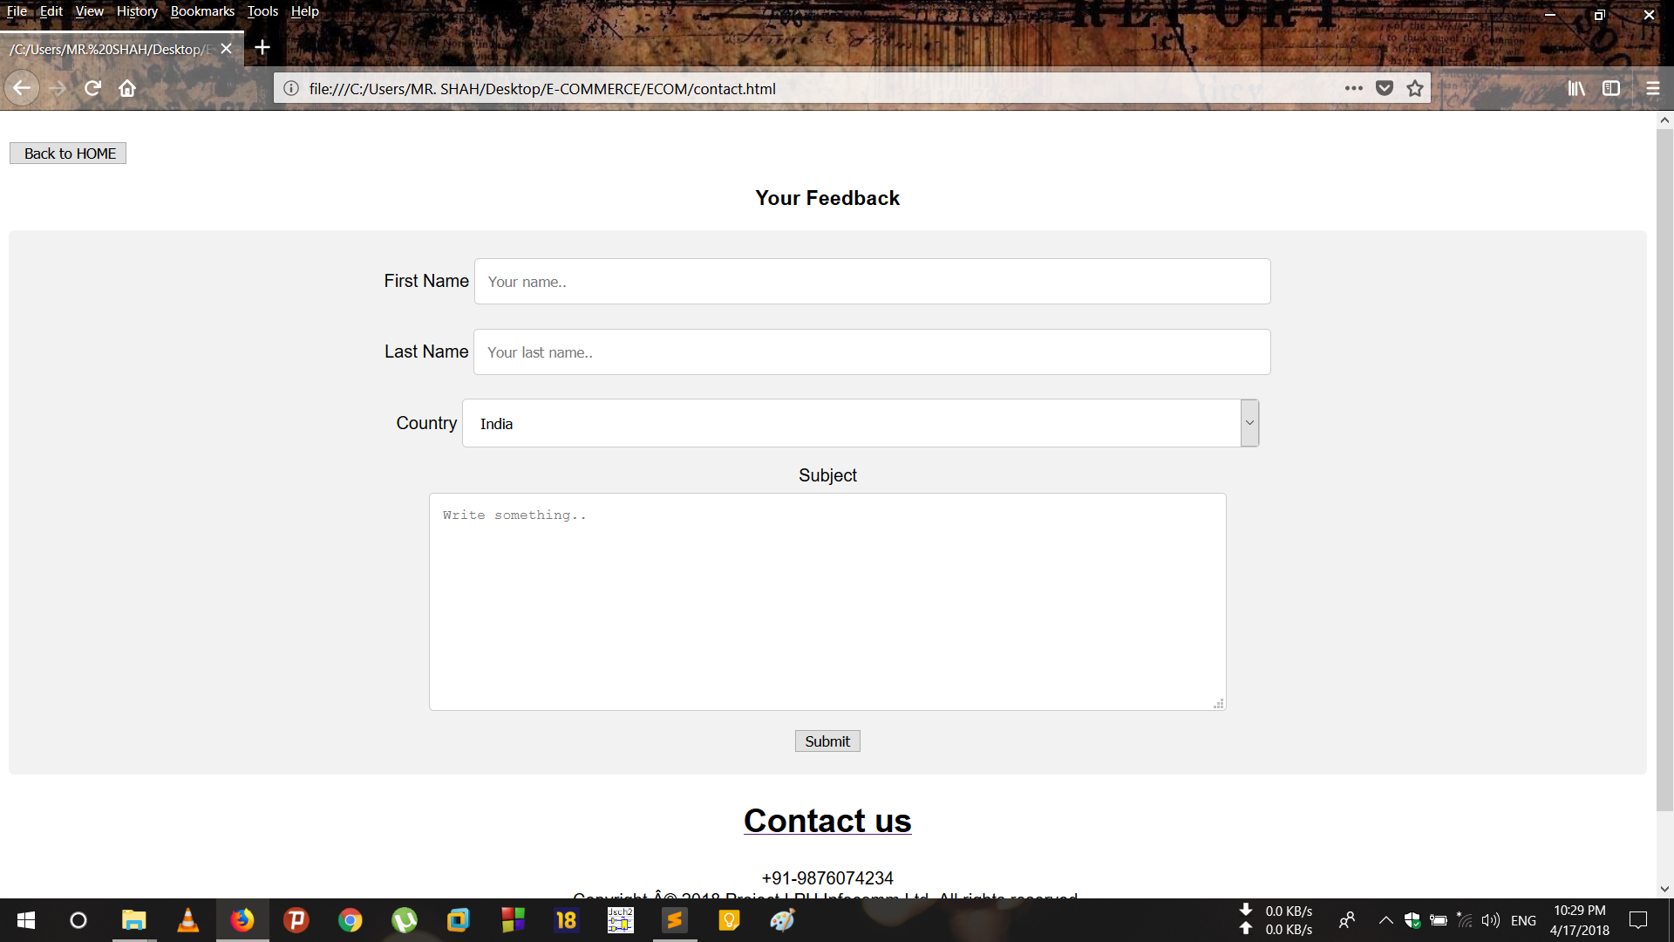
CONTACT US PAGE-

Slide 8
MODULES USED IN THE PROJECT-
HTML ATTRIBUTES USED–
HEADINGS
PARAGRAPH
BUTTONS
BACKGROUND
IMAGES
CSS ATTRIBUTES USED –
ICONS
PADDING
FORMS
JAVASCRIPT ATTRIBUTES USED –
SLIDESHOWS
SUBMIT ONCLICK FORM ACTION

Slide 9
THANK YOU-

